Slide 1

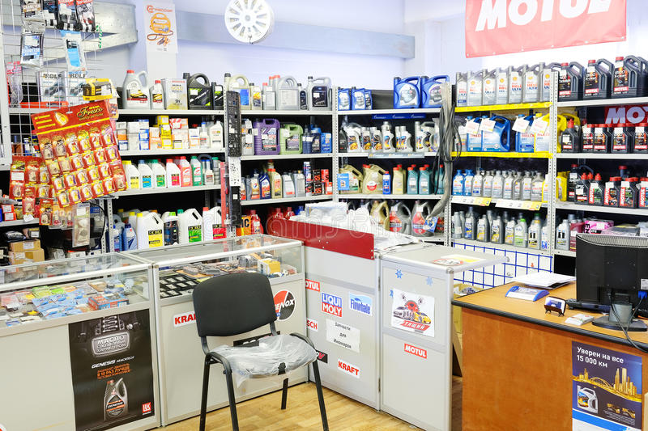
MAHLE Auto Marketing Strategy
Create Awareness, Attract Customers, Build Relationships

Slide 2

Persona 1
The local community members represent the largest share of MAHLE Auto customer base, and are the best
opportunity for repeat customers.
This car owner can’t afford not to have a car for hours at a time
Car Owner
Bio
A trip to the auto shop shouldn’t stress this client
Goals/Needs
Needs a one stop trusted spares shop that sells quality products that are reasonably priced
Biggest Challenges/Frustrations
Finding quality spares that are reasonably priced
Marketing Channel: Social Media, Outbound

Slide 3
Messaging Angle
Marketing messaging should communicate one or more of the following:
Safe and convenient
Impeccable customer service
Trusted and solves all their problems
Reasonable prices
Quality products

Slide 4
The Strategy - Out of Home
Out of Home(OOH)
OOH also known as outdoor promotion strategy is a marketing technique that reaches out to potential clients outside their homes. You can’t hide a billboard the way you close a popup window. This makes outdoor advertising inevitable. It includes billboards(mobile, digital, static), street posters, retail signage…. We’ll also add point-of-sale to this mix.
Strategy #1: Take The Road Less Traveled
Goal: Reach new customers as efficiently as possible.
Approach: Run ads in underutilized markets, away from where every other spares shops. Use Static and Digital Billboards
Strategy #2: Share the (Brand) Love
Goal: Make a big brand splash.
Approach: Run unforgettable ads on freeways. They aren’t necessarily designed to drive immediate conversion as they are to simply tell consumers, “We exist and you should get to know and love us because we are the best of the best.” Use Static (including 3D) and Digital Billboards.
Strategy #3: Follow the Consumer
Goal: Reach a specific target audience.
Approach: Use audience data and filters to surface the most audience-relevant ad units. Distribute flyers, insert flyers in newspapers, road shows, megaphones at store

Slide 5
The Strategy – Digital Marketing
Digital Marketing is easy , affordable, and effective. The main objectives of MAHLE Auto’s digital marketing strategy include:
Creating Awareness
Creating Buzz
Creating a strong brand
Generating interest
Disseminating information

Slide 6
The Strategy–Digital Marketing–Social Media
General Strategy to Achieve Goals:
Craft visual identity for all pages
Adjust all bio and information on all channels to improve search
Add themes and details to content calendar for the year
Monitor conversations
Client to add social media addresses to email signatures, all print marketing materials
Train staff on posting and social media basics for each platform including any third-party apps
Monthly reporting on numbers, engagement and influence
FACEBOOK
Facebook allows for real-time updates and interactions, while offering space for longer posts and add-ons
such as event pages, groups, and applications. Facebook is where MAHLE Auto’s personality will shine!
Set up and branding of profile
Add iFrames to Facebook - link to relevant website pages
Create “Calls to Action”
Post once daily, 4-7 days per week
Share relevant articles
Share photos
Tag other like-minded organizations
Create YouTube tab to share videos
Advertise $5 - $10 per day for first five days after initial launch
Reassess after five days of advertising
Look at Return On Investment
Determine next steps

Slide 7
The Strategy – Digital Marketing – Content strategy
The way in which people seek, consume and engage with information online varies depending on the platform being used. The following guidelines have been developed to ensure Mahle Auto provides relevant and useful information on all digital platforms.
Platform | Content Type
Website | All written content lives here. This is the information hub – the heart of the Mahle Auto's online presence. Include blogs and website copy
Google My Business Service | Related information (e.g. contact details, opening hours, services, reviews).
Facebook | Videos and curated content primarily targeting residents. Links (URLs) back to the website to drive website visitation.
Instagram | Aesthetically appealing, high resolution photos and videos. More organic (spur of the moment) content is suitable for Stories and Reels.
LinkedIn | Business to business (B2B) information. Professional and topical content. Images and video valuable.
Twitter | Topical news, trending issues, unique insights and thought leadership content.
YouTube | All video content lives here. Live and pre-recorded.

Slide 8
The Strategy – Digital Marketing – Content strategy
Frequency and length of content
There is no standard for the frequency at which MAHLE Auto should upload content as it will differ depending on the platform. The frequency at which content is published will be based on the analytics, which will be reviewed regularly to determine when stakeholders are online.
There is also no golden rule when it comes to the length of digital marketing content, but research shows that shorter content tends to get better interaction. For social media, generally 100 characters or less increases the chance of engagement.
Platform | Ideal Post Length (Characters)
Website update/blog | 500-1500
Facebook post | 40 - 80
Instagram caption | 100 - 150
LinkedIn update | 50 – 100
Twitter post | 71 – 100
YouTube video | 8 minutes

Slide 9
The Strategy – Digital Marketing- SEO
On-Page SEO
New Page Creation
Create or update pages according to persona, keyword, & competitor research.
Create or update geocentric, solution, industry, press, reviews/testimonials, referrals, privacy/terms, policies, thank you, & other important pages.
Implement structured data opportunities specific to your industry (reviews, URL breadcrumbs, knowledge graph, & more).
On-Page SEO
Revise all titles, meta descriptions, & headers.
Add, improve, & optimize images while defining keyword-rich image filenames & alt attributes.
Improve anchor text for internal & outbound linking.
Improve content through keyword research & best practices.
Improve readability & content segmentation.
Conversion Rate Optimization (CRO)
Evaluate forms, CTAs, smart content, & other possibilities including live chatbots & pop-up offers.
Add trust symbols available near forms, footer, & conversion areas.
Assist with A/B & multivariate testing.Create an update schedule to maintain freshness.
Add user engagement features, like progress indicators, to increase dwell time.

Slide 10
The Strategy – Digital Marketing- Email
Email Marketing Strategy
Email marketing goals:
Increasing conversion
Building brand trust
Decreasing churn
Driving engagement
To start the process, signup with a professional email marketing service. The most common are:
HubSpot
Mailchimp
Constant Contact
SendinBlue
Wordpress plugins

Slide 11
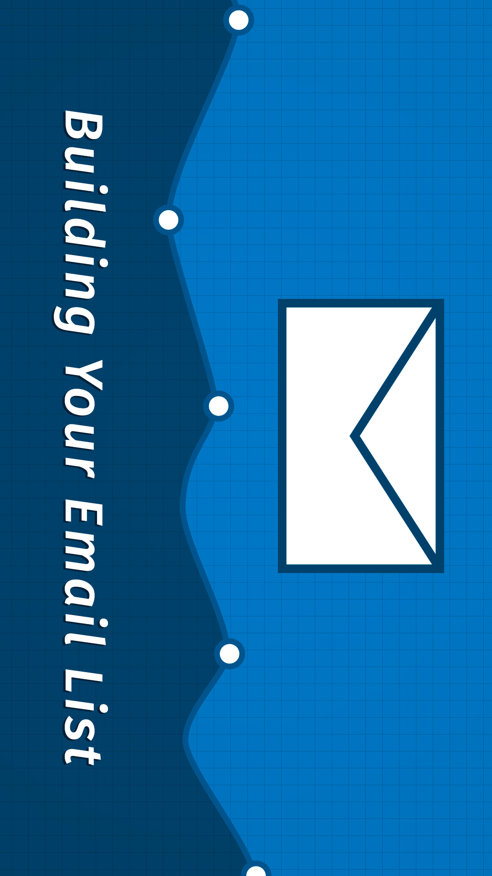
The Strategy – Digital Marketing- Email
Effective list building strategies
Use Multiple Signup Forms on website(Sidebar, popup, floating)
Use an Exit-Intent Popup on website
Add Fully or Partially Gated Content in WordPress
Start blogging (brings people to the site and boosts SEO)
Run Giveaways and Contests
Create Multiple Lead Magnet Pages (offer something free eg ereport)
Use Discounts and Deals
Answer Quora/Reddit questions with link to lead magnet pages
Use Contact Form to Grow Your Email List
Add Sign Up Call to Action on Your Facebook Page
Answer questions in Facebook groups with link to signup page
Use Twitter Lead Generation Cards
Use YouTube Call to Action Cards
Use After Post and In-Line Optin Forms
Add Polite Slide-in Scroll Forms
Use Prominent Headers With Call to Action
Use Social Proof to Encourage More Sign Ups
Use Gamified Campaigns (Coupon spin a wheel)
A/B Test Your Optin Forms

Slide 12
The Strategy – Digital Marketing- Reporting
Reporting Structure
Monthly digital marketing report
On a monthly basis, MAHLE will prepare a summary of results for the previous month.
This data will be extracted directly from each platform’s inbuilt insights, Google Analytics
or automatically generated via Hootsuite.
Internal benchmarking
For benchmarking purposes, MAHLE Auto will compare its digital marketing activity (increase and decreases to key metrics) month on month. In addition, 6 and 12 month targets should be set for each of the metrics above. As a general guide, MAHLE Auto should aim to increase its current (results) activity by 5 – 10% each year.

